Slide 1
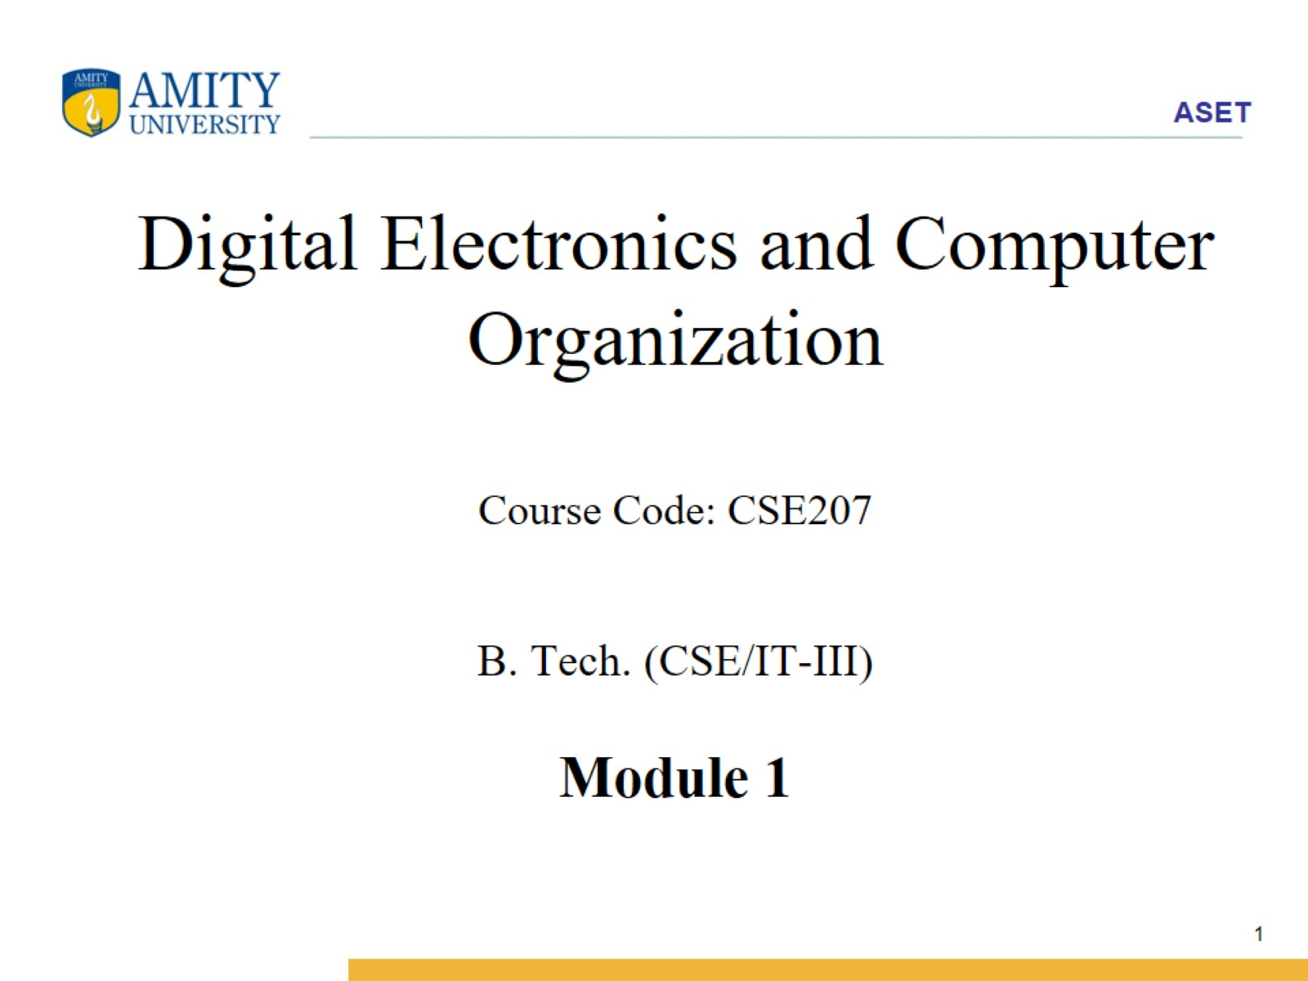
Digital Electronics and Computer Organization Course Code: CSE207 B. Tech. (CSE/IT-III) Module 1

Slide 2
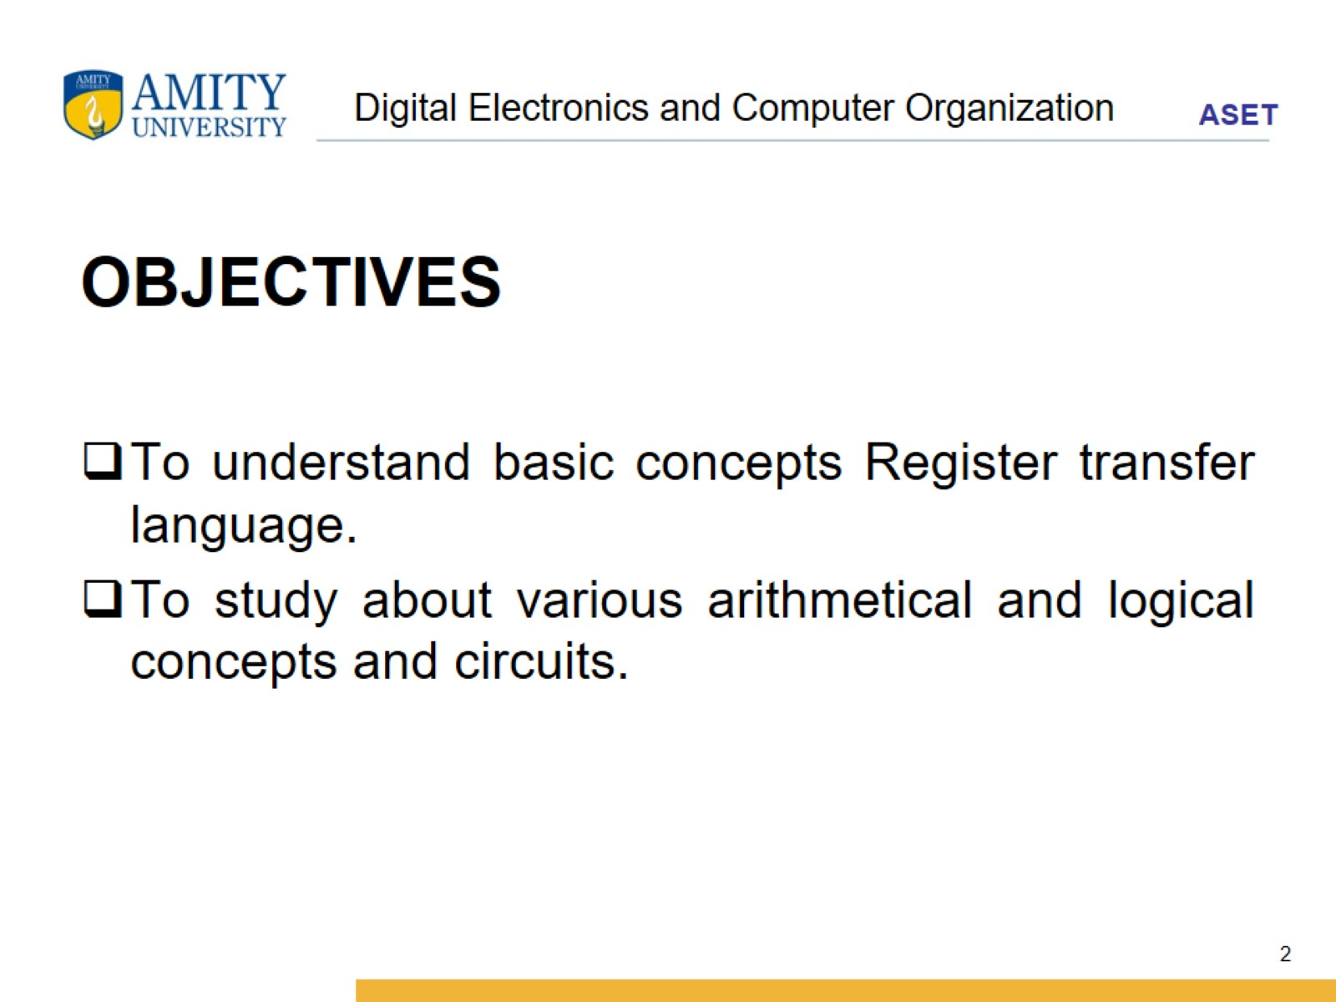
Digital Electronics and Computer Organization

Slide 3
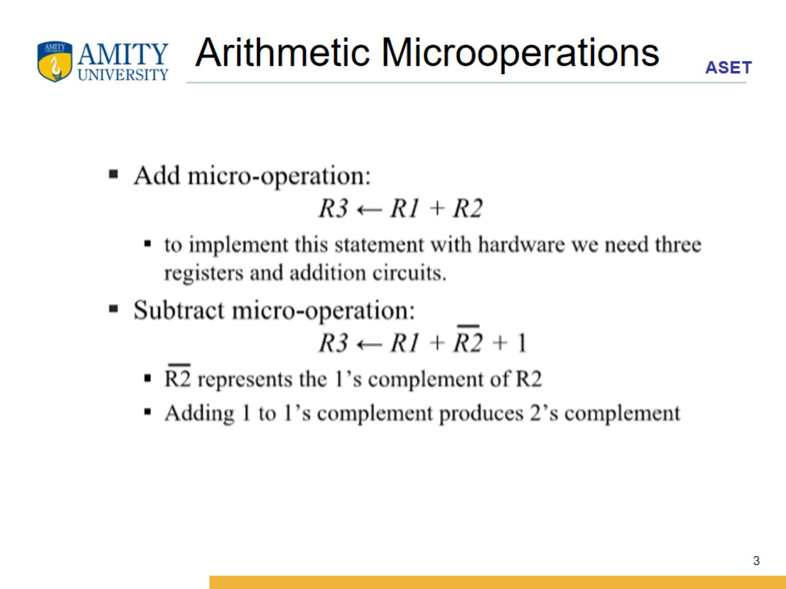
Arithmetic Microoperations

Slide 4
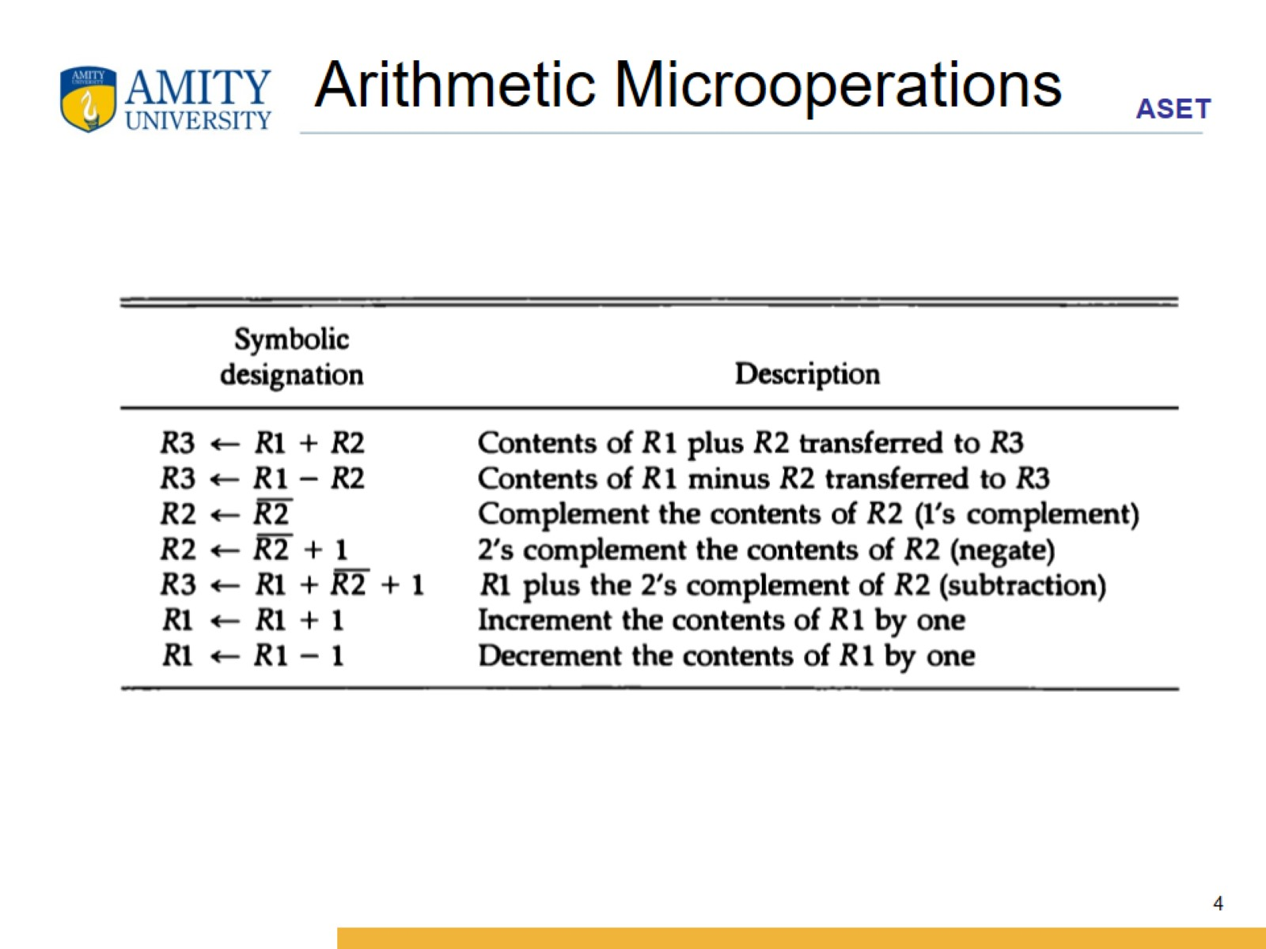
Arithmetic Microoperations

Slide 5
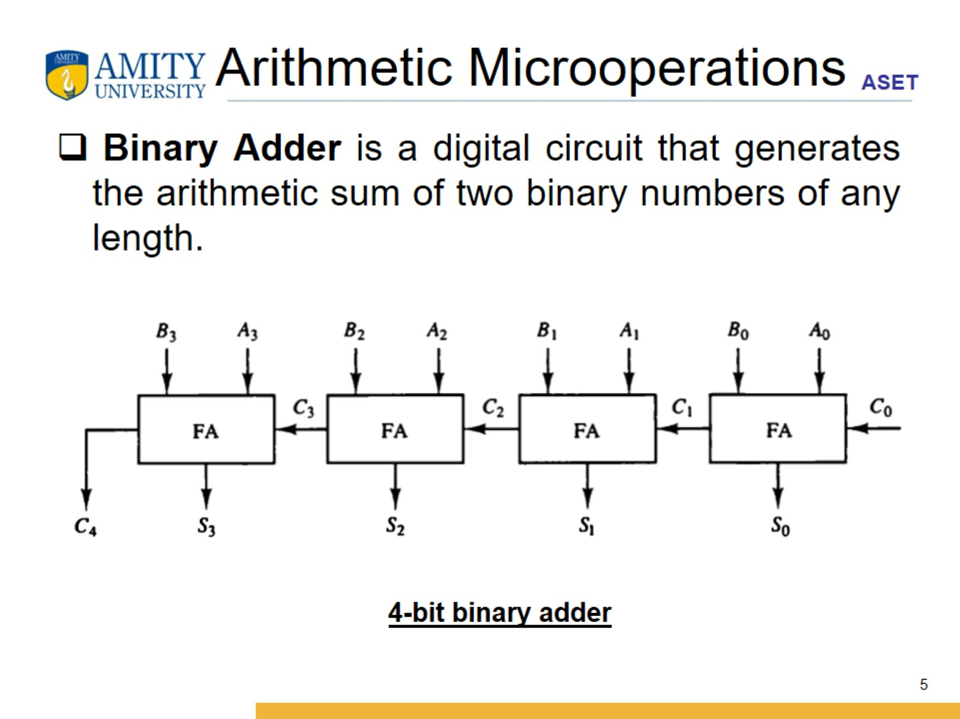
Arithmetic Microoperations

Slide 6
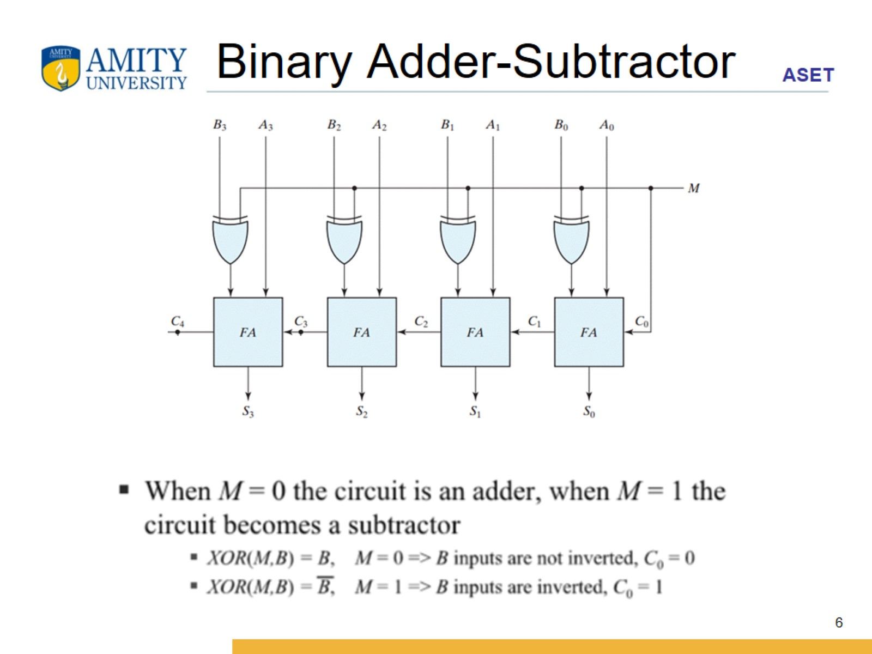
Binary Adder-Subtractor

Slide 7
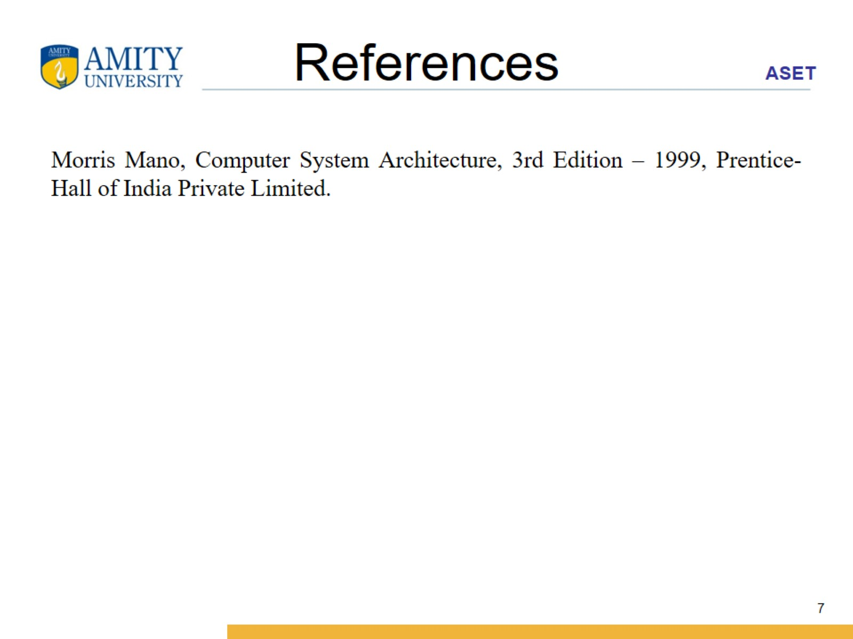
References

